Slide 1
Bioethics
Problems of transplantation
Prоf. Tsybusov Sergey Nikolaevich

Slide 2
TRANSPLANTATION (from Latin transplantare – «replant», «replace») is the process of replacing damaged or lost organs by transplanting the same organs taken from healthy organisms of the same species.

Slide 3
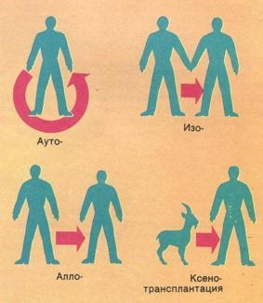
There are 3 types of transplantation:
Autotransplantation – transplantation in one organism
Allo-or Homo-transplantation - transplantation in one species
Xenotransplantation – transplantation from one species to another

Slide 4
All transplantation operations are divided into:
Transplantation of organs or organ complexes(transplantation of a heart, kidney, liver, pancreas, heart-lung complex) and
Transplantation of tissues and cell cultures (transplantation of bone marrow, β cell cultures of pancreas, endocrine glands etc.)
Sources of organ and tissue transplants:
Cadaveric donation -75-90%
Living donors
Artificial organs and tissues
Animal organs (xenotpansplants)

Slide 5
In Italy in the Museum of St. Mark (frescoes of the 15thcentury)
Saints Cosmas and Damian (3rd century AD) transplant
the black leg of the Ethiopian onto the deacon Justinian.

Slide 6
”Legendary” transplantation
Saints Cosmas and Damian, supported by angels,transplant the black leg of the Ethiopian into a white body.16th century painting.

Slide 7
Vladimir PetrovichDemikhov (1916-1998)
In 1946 he conducted world’s first heart transplantation
into the chest of a dog. In 1954 he transplanted a head
of a dog on to another larger dog

Slide 8
In 1967, the world's first successful human-to- human heart transplant was performed.

Slide 9
It was carried out by a pupil of V. Demikhov
South African doctor Dr. Christiaan (Chris) Bernard.

Slide 10
The first successful heart transplant in Russia was performed by V.I. Shumakin in 1986.

Slide 11
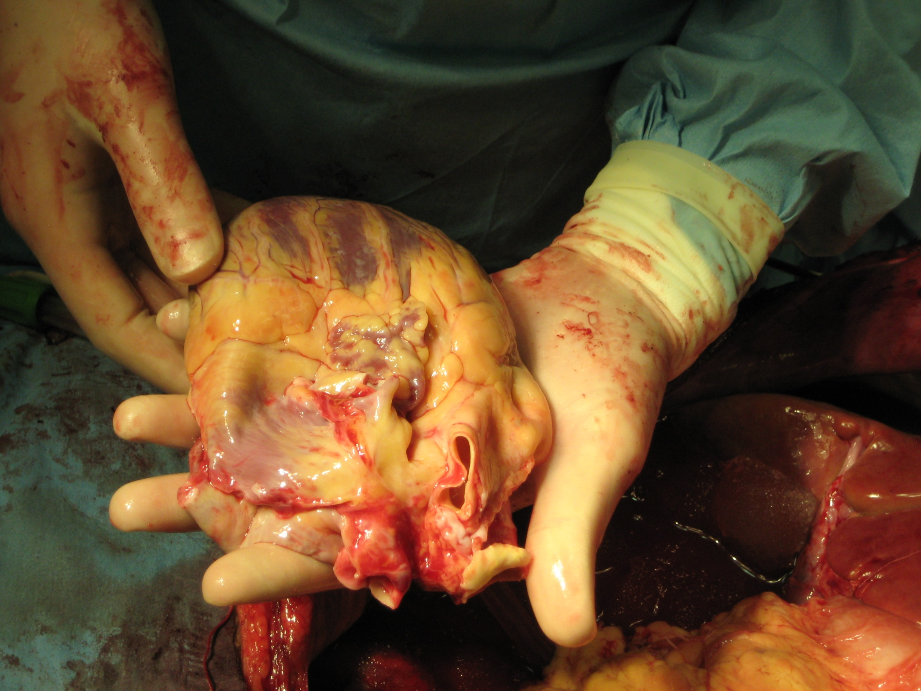
. Ethical Issues Surrounding Transplantation

Slide 12
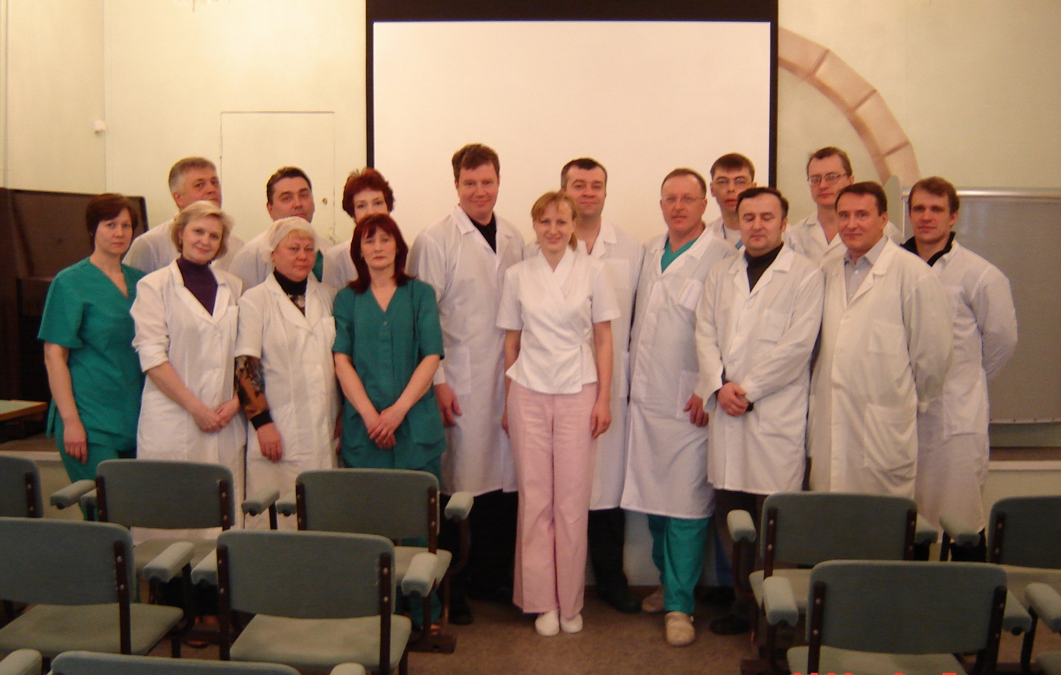
6 МАРТА 2006

Slide 13
Ethical concerns in transplantation
1. Commercial relations in transplantation
2. Brain-based determination of death (determination of death by criteria for brain death)
3.Explantation (removal) of organs and (or) tissues from a corpse or living donor
4.Fair distribution of available donor organs or recipient tissues

Slide 14
The danger of commercializing donation
Trade in organs and tissues should be prohibited by law.
Monetary exploitation of both patients who need donor material
and donors who donate their organs for money inadmissible.

Slide 15
World Medical Association, Declaration on
Human Organ Transplantation (1987).
Purchase and sale of human organs for transplantation is condemned.

Slide 16
Law of the Russian Federation “On the transplantation of organs and(or) human tissues” (1992)
A ban on purchase and sale of organs for transplantation was introduced.

Slide 17
REASONS FOR THE COMMERCIALIZATION OF ORGAN AND TISSUE TRANSPLANTATION
Shortage (deficit) of organs for transplantation, forcing patients to look for unusual sources of donor organs
Impoverishment of a significant part of the population, capable of pushing people to seek income even by selling their own organs
Crisis in budget financing and inadequate financing through compulsory health insurance encourages medical institutions to fight for survival by commercializing their activities

Slide 18
FACTS
Every 18 minutes a new name was added to the waiting list for transplantation in 1998, every 16 minutes in 1999, every 14 minutes in 2001 and every 10 minutes in 2005.
The speed of adding names to the waiting list has long exceeded the speed of exit from this list.
More than 120 thousand people are currently awaiting the donor organ.

Slide 19
PROBLEM
For the sake of saving one person, is
a doctor entitled to harm the health
and wellbeing of another person?

Slide 20
Potential donor's right to altruism
and self-sacrifice
Art. 13 of the RF Law “On the transplantation”
A living donor may have a paired organ,
part of an organ or tissue removed for transplantation, the absence of which does not entail an irreversible health problems –
the donor has no right to sacrifice his own life by giving an unpaired vital organ.

Slide 21
REMOVAL OF ORGANS AND TISSUES FROM
A LIVING DONOR
Art.11 of the RF Law “On the transplantation” is allowed under the following conditions:
If the donor has given free, informed and specific consent to it in written form.
If the donor beforehand has been given appropriate information as to the purpose and nature of the removal as well as on its consequences and risks.
If the donor has undergone a comprehensive medical examination and has the opinion of a Council of medical specialists on the possibility of removing his organs or tissues for transplantation

Slide 22
PROBLEM
For the sake of saving one person, is a doctor entitled
to remove organs and tissues from a recently died person?

Slide 23
DEFINITIONS OF BRAIN DEATH
Death of the entire brain, including the brainstem”with irreversible unconsciousness, cessation of independent breathing and absence of all brainstem reflexes.
Death of the brain stem (however, signs of brain vitality, in particular electrical activity, may persist).
Death of the parts of the brain responsible for consciousness, thinking, i.e. for a man preservation as a person

Slide 24
DIAGNOSIS OF BRAIN DEATH
Art.66 of the Federal Law of the Russian Federation No 323-FZ of 21.11.2011 "On the fundamentals of health protection of citizens in the Russian Federation’
The diagnosis of brain death is established by a consultation of doctors in the medical organization in which the patient is located.The consultation of doctors should include an anesthetist-resuscitator and a neurologist with at least three years of experience in the intensive care and resuscitation department.

Slide 25
Principle of organizational and financial independence of medical teams
There should be three medical teams, each of which performs certain functions.
The first states "brain death", the second carries out organ harvesting and the third - a team of transplantologists - performs organ transplantation.

Slide 26
Ethical and legal regulation of postmortem explantationof human organs and/or tissues
The main source of organs and/or tissues for transplantation is cadaveric donation. There are several types of legal regulation of recovery of all transplantable cadaveric organs.
There are three main models of recovery of all transplantable cadaveric organs: routine recovery of all transplantable cadaveric organs, the principle of presumption of consent and the principle of presumption of disagreement

Slide 27
Routine recovery
The basis is the established practice according to which the authorities may, at their discretion, dispose of the body of a deceased person.
In particular, they give health services the authority to perform an autopsy, to remove organs for scientific and other manipulations, and to use physiological fluids and tissues of a corpse for a wide variety of purposes.
The human body in this case is considered as state property, which physicians can use in the public interest.

Slide 28
MECHANISM OF PRESUMPTION OF CONSENT(OR PRESUMED CONSENT)
This principle differs from routine recovery in that although a special permission for posthumous organ donation is not requested, consent for it is presumed, i.e. refusal from such manipulation has not been registered.
The current law on transplantation offers every adult while he or she is alive and his or her family after his or her death the opportunity to refusefrom organ and/or tissue donation.

Slide 29
PRESUMPTION OF CONSENT(presumed consent, objection model)
Consent is presumed because people do not express their disagreement explicitly throughout life
+The positive thing is that this principle provides a source of a large number of organs and tissues for transplantation. | - The negative thing is that the principle of presumption of consent forces the doctor to commit, in fact, a violent action, because the action with a person or his/her property without his/her consent is qualified in ethics as violence.

Slide 30
PRESUMPTION OF DISAGREEMENT
The presumption of disagreement suggests that the person does not agree in advance that his/her organs will be transplanted into another person. Organs can be removed from the body of a deceased person for transplantation when an individual or his/her family after he/she dies specifically expresses desire to donate his/her organs.

Slide 31
PRESUMPTION OF CONSENT AND DISAGREEMENT
The presumption of consent is valid in Russia, Austria, Belgium, Spain, the Czech Republic, Hungary, etc.
The presumption of disagreement is enshrined in the laws of the United States (partially), Canada, Germany, France, Portugal, the Netherlands and is actually valid in Poland.

Slide 32
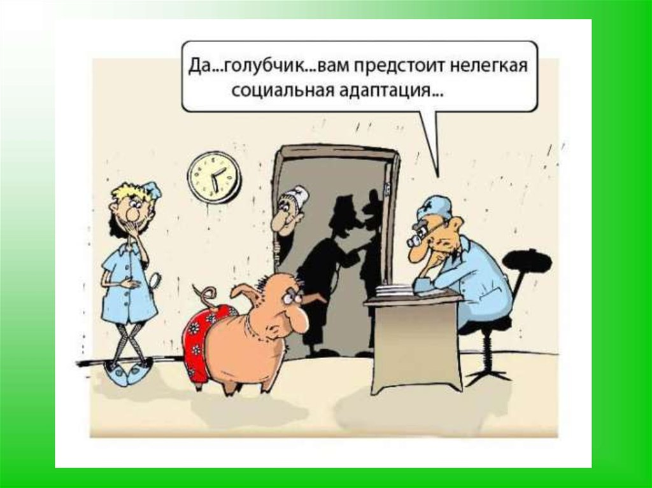
. Yeah.., my dear, you are about to have a difficult social adaptation

Slide 33
FACTS
Every 18 minutes a new name was added to the waiting listfor transplantation in 1998, every 16 minutes in 1999, every 14 minutes in 2001 and every 10 minutes in 2005.
The speed of adding names to the waiting list for transplantation has long exceeded the speed of exit from this list.
More than 120 thousand people are currently awaiting the donor organ.

Slide 34
CRITERIA OF THE "QUEUE" FOR ORGAN AND TISSUE TRANSPLANTATION
- Degree of immunological compatibility in the donor-recipient pair"
- Recipient severity criterion
- Refusal to transplant donor organs into a patient suffering from diseases accompanied by damage to the peripheral vascular system, because of the potential risk for failure in organ transplantation.

Slide 35
BASIC ETHIC PRINCIPLES REGULATING THE HUMAN ORGAN AND TISSUE TRANSPLANTATION
1. Human organs cannot be considered as objects of purchase and sale.
2.Organ transplantation from a living donor can only be based on voluntary self-sacrifice to save the life of another person.
In this case, consent to the removal of organs becomes a manifestation of love and compassion.
3.The potential donor should be fully informed about the possible health consequences of organ explantation.
4. From a moral point of view, explantation that directly threatens the life of a donor is unacceptable. According to Russian law,
organ removal from a living donor is allowed only in case of donor-recipient genetic relationship, with the exception of cases of bone marrow transplantation.
5. It is unacceptable to reduce the life of one person, including through the rejection of life-supporting procedures, in order to prolong the life of another.

Slide 36
6.The most common practice is to remove an organ from people who have just deceased. Here it is necessary to eliminate ambiguity in determining the moment of death.
7. There are three principles for the ethically and correct diagnosis of “brain death”:the principle of a unified approach, the principle of collegiality and the principle of financial and organizational independence of medical teams.
8. Priority allocation of donor organs should not be determined by the identification of the benefits of individual groups and special funding.
9. When distributing donor organs, three criteria are taken into account: immunological donor-recipientcompatibility, degree of severity of recipient status, and priority.
10. It is morally unacceptable to use the most unprotected and being in extreme situations contingents of people: homeless people, psychiatric patients, children, residents of economically backward countries.

Slide 37
Спасибо за внимание !

